Slide 1

Master Thesis
Evaluation of Image-Based Approaches
Extracting a Mandrel’s Borders Using Machine Vision
Benedikt Haas
cand. el. Dinggen Dai

Slide 2
Structure
1 Motivation and Objective
2 Concept
3 Methods
4 Result and Evaluation
5 Conclusion and Outlook

Slide 3
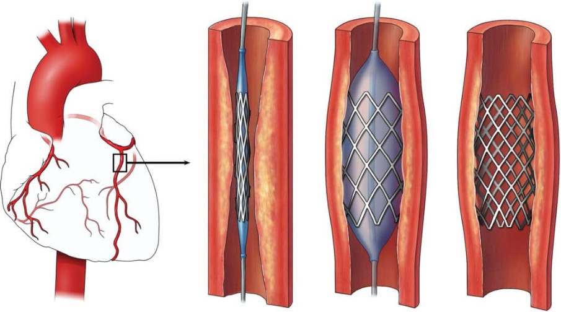
1 Motivation and Objective
Cardiovascular diseases caused 338,000 deaths [1]
22.3% due to narrowing of heart disease vessels
Treatable by stent implementation [2]
Stent quality control in manufacturing is essential
manual inspection VS. automatic inspection
Stent implementation process [2]

Slide 4
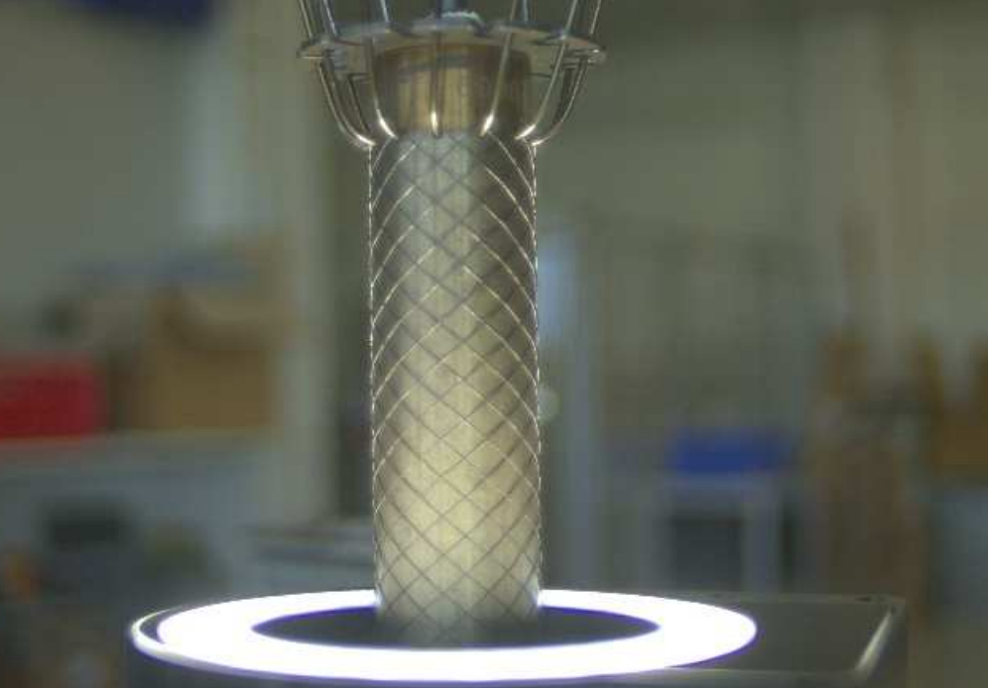
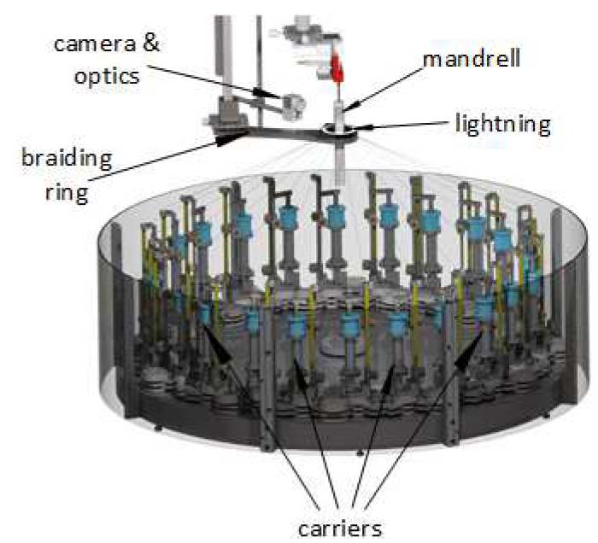
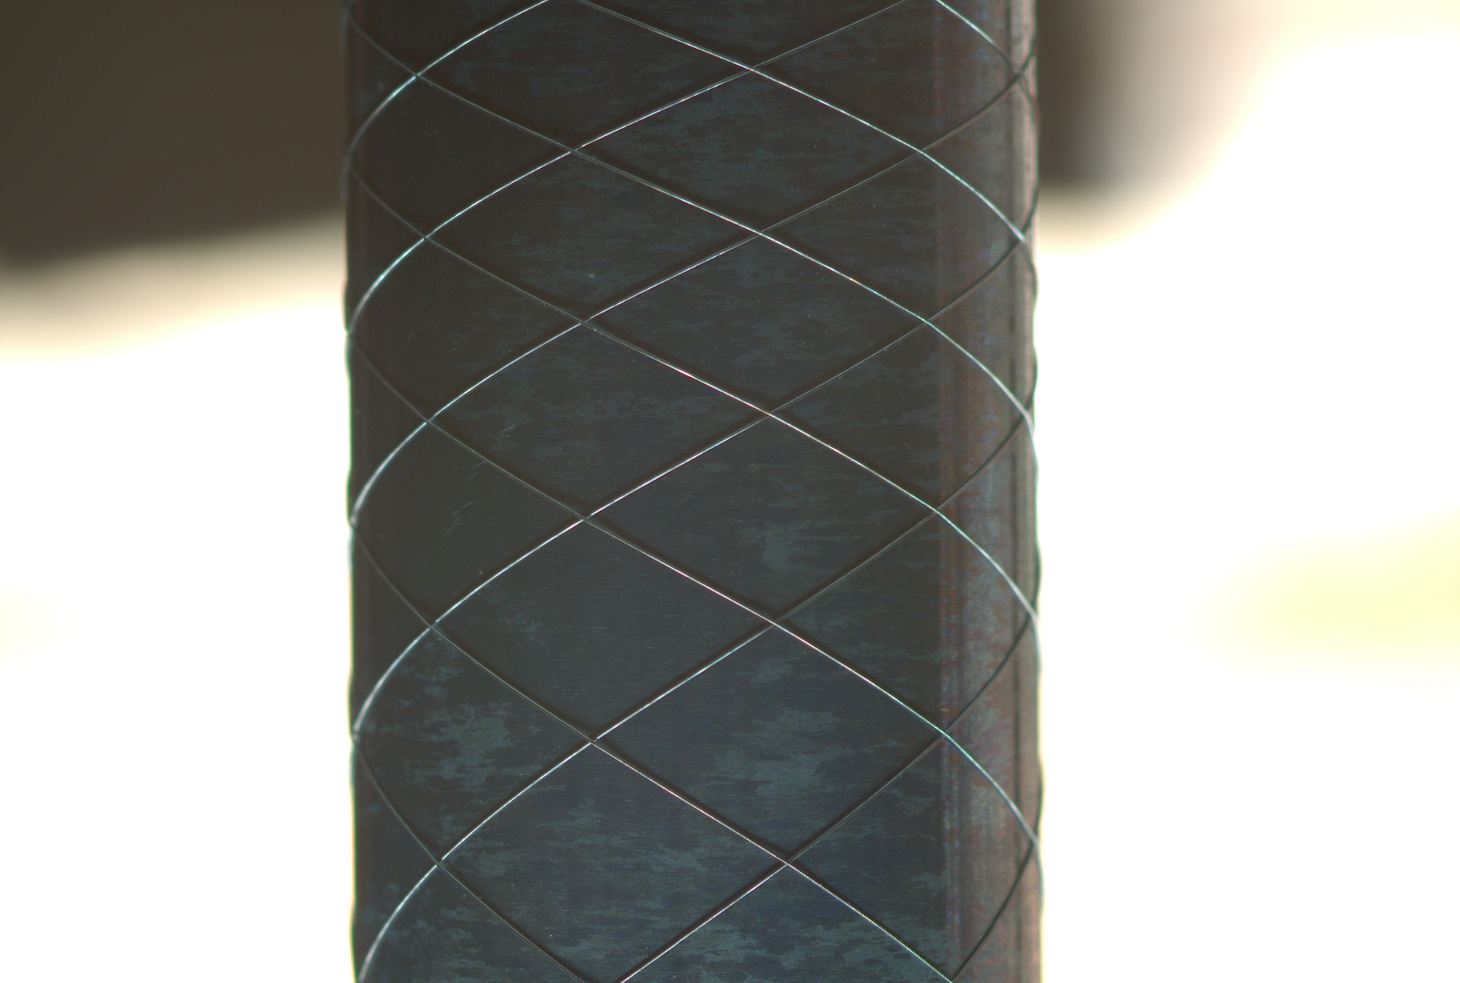
Motivation: Stent4Tomorrow
visual inspection related parts
of the system [3]
manufacturing system [3]
focus on the stent

Slide 5
Objective: Borders extraction
Issue 1: the pitch size
how to “enlarge”?
Issue 2: the background useless
how to remove?
Solution: borders extraction!
Extra: the diameter of the mandrel already known (in mm)
calculate the distance of the borders
build mapping relations between image (in pixel) and human perception (in mm)

Slide 6
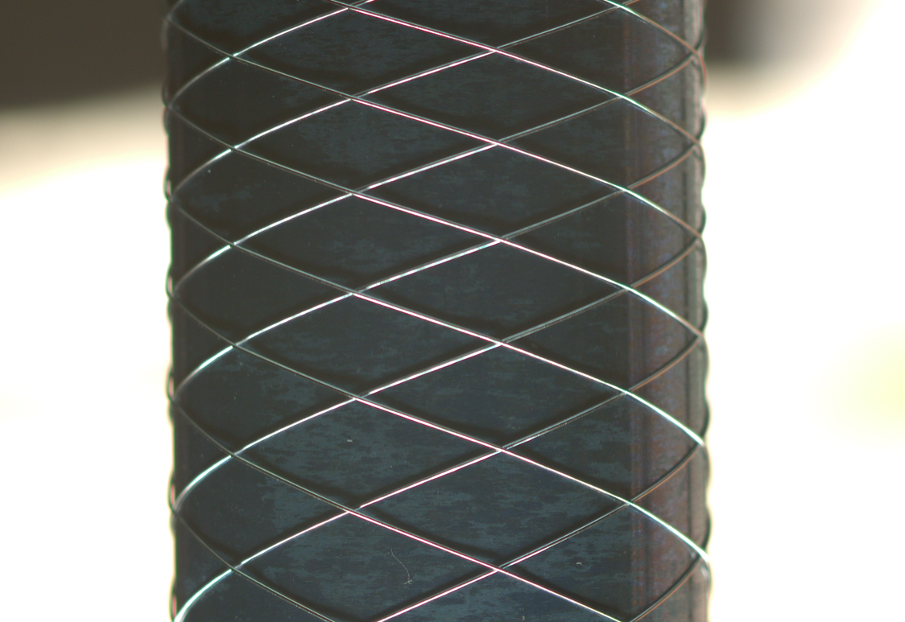
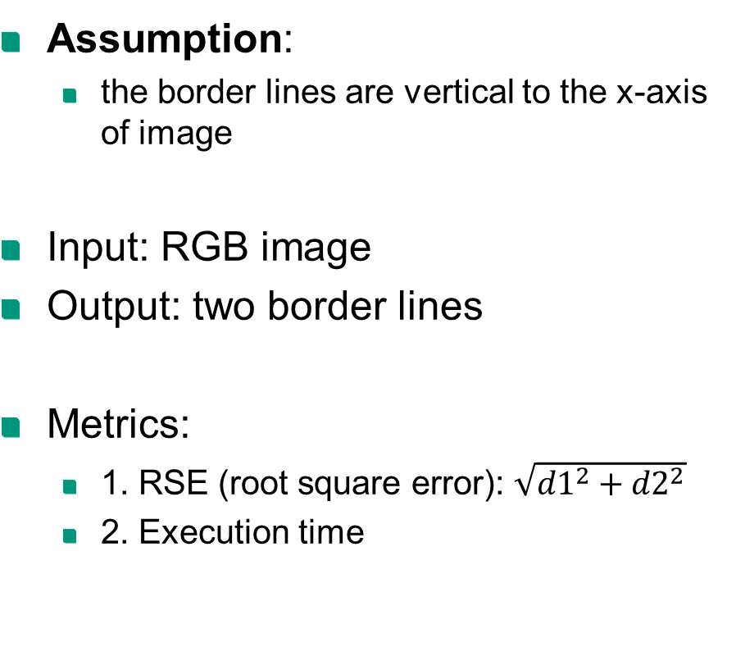
2 Concept
x
Assumption:
the border lines are vertical to the x-axis of image
Input: RGB image
Output: two border lines
Metrics:
1. RSE (root square error): $\sqrt{{d1}^{2}+{d2}^{2}}$
2. Execution time
y
d1
d2

Slide 7
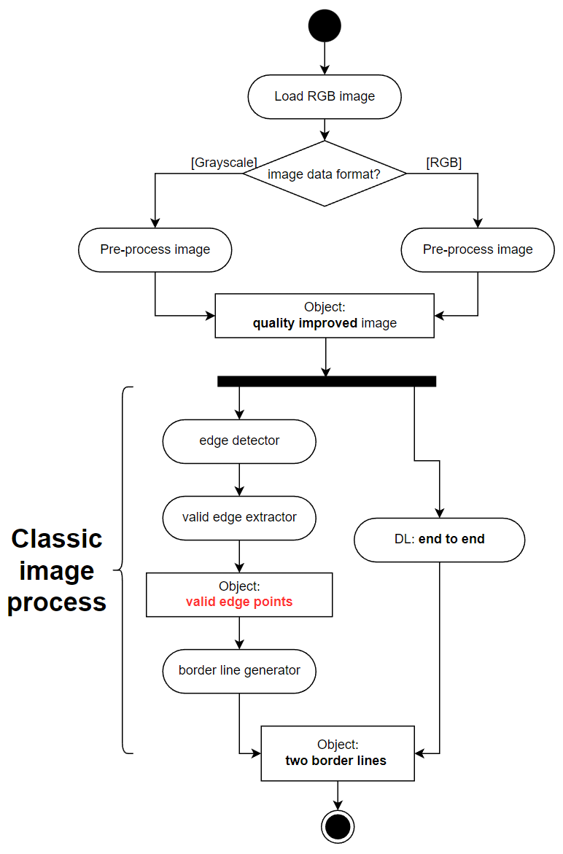
Concept: diagram

Slide 8
3 Methods: Dataset
Original Image (RGB):
size: 2064*3088*3 ( > 5 MB )
The labels:
two border lines vertical to the x-axis
format: [x_left_border, x_right_border]
Dataset splitting:
 | Training | Validation | Test
Total | 5529 | 1224 | 1694
Usable¹ | 4881 | 1085 | 1508

Slide 9
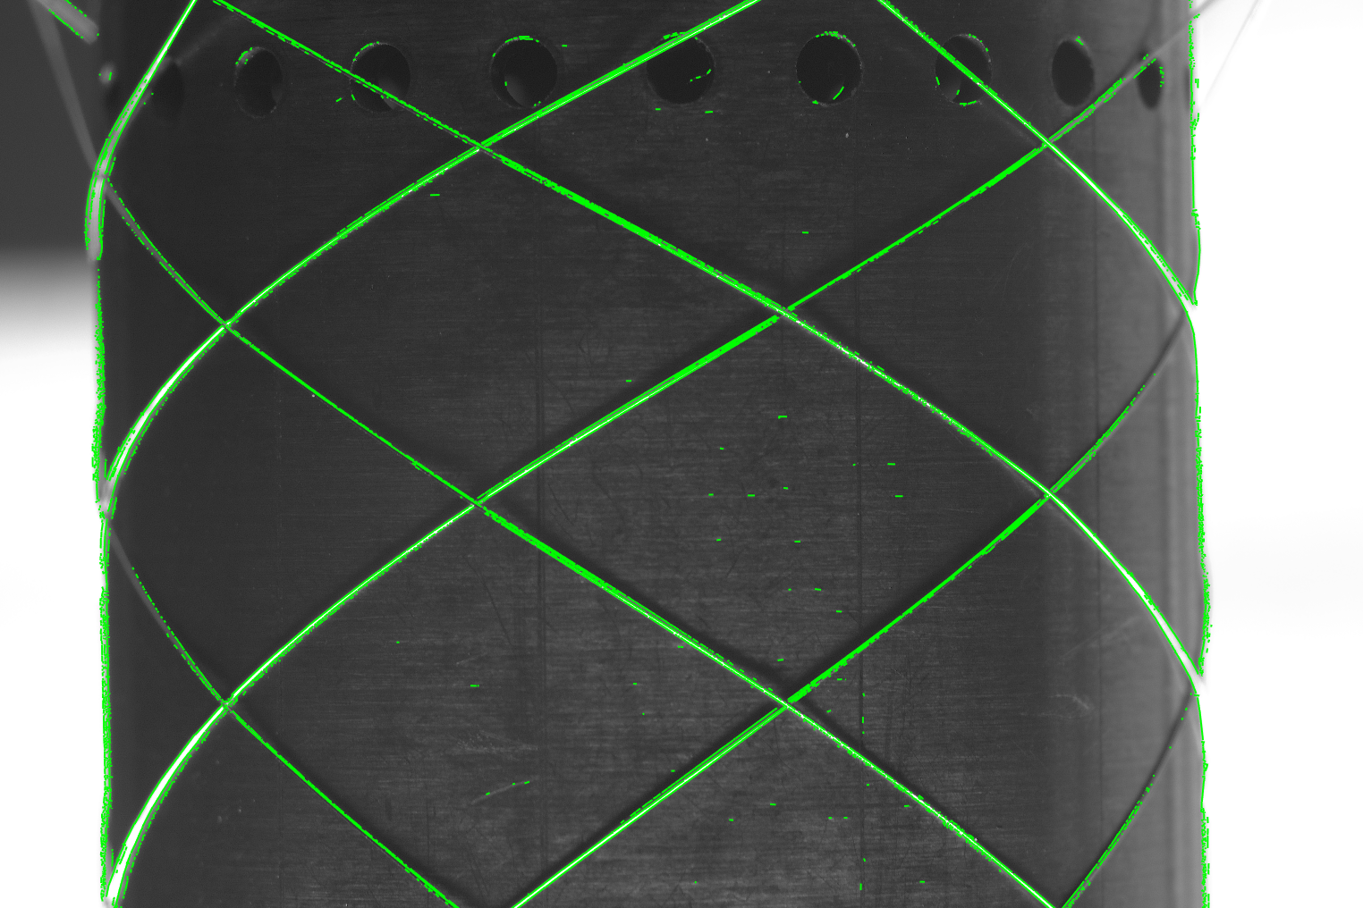
Method: classic image process
Step 1. edge detector
Bottom-up approachs:
LSD (2010): still typical today [4]
EDLines (2011): 10 times faster than LSD [5]
CannyPF (2015): parameter free [6]
Top-down approachs: based on hough transformation
MCMLSD (CVPR 2017) [7]
Step 2. valid edge extractor
filter: moving window
Step 3. border line generator
least square method

Slide 10
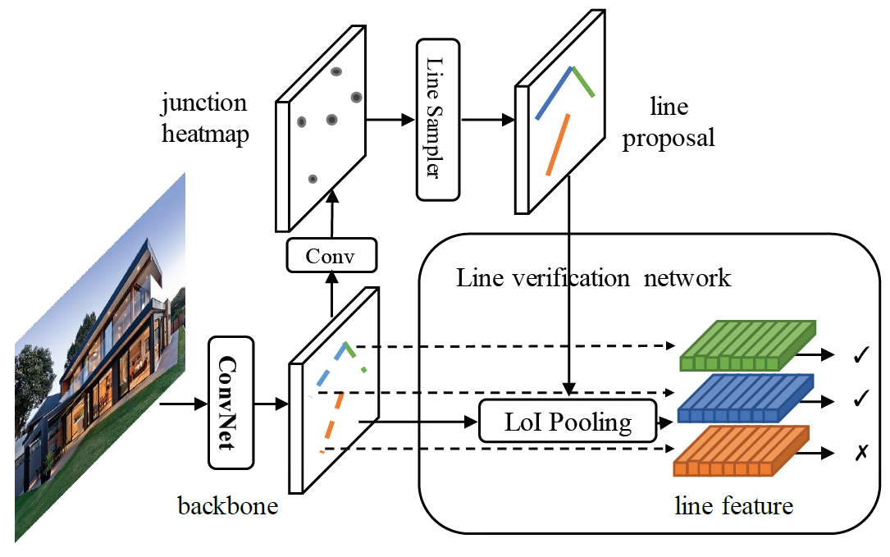
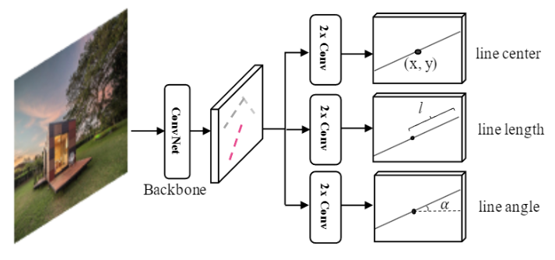
Method: deep learning
HT-LCNN (ECCV 2020) [8]
based on LCNN (ICCV 2019)
add a trainable Hough transfrom block into a deep network
F-Clip [9]
SOTA of line detectors (2021)
one stage: much more faster
the representation of a line
An overview of LCNN architecture
An overview of F-Clip architecture

Slide 11
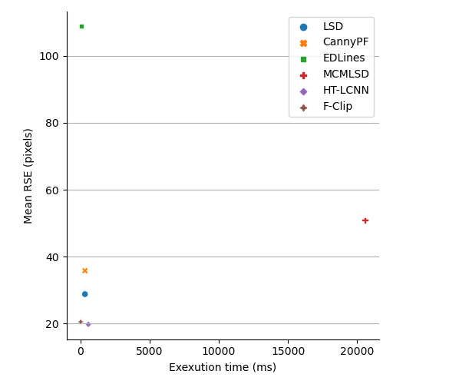
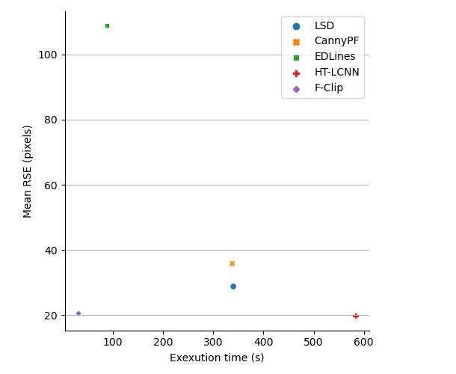
4 Result & Evaluation
Without MCMLSD

Slide 12
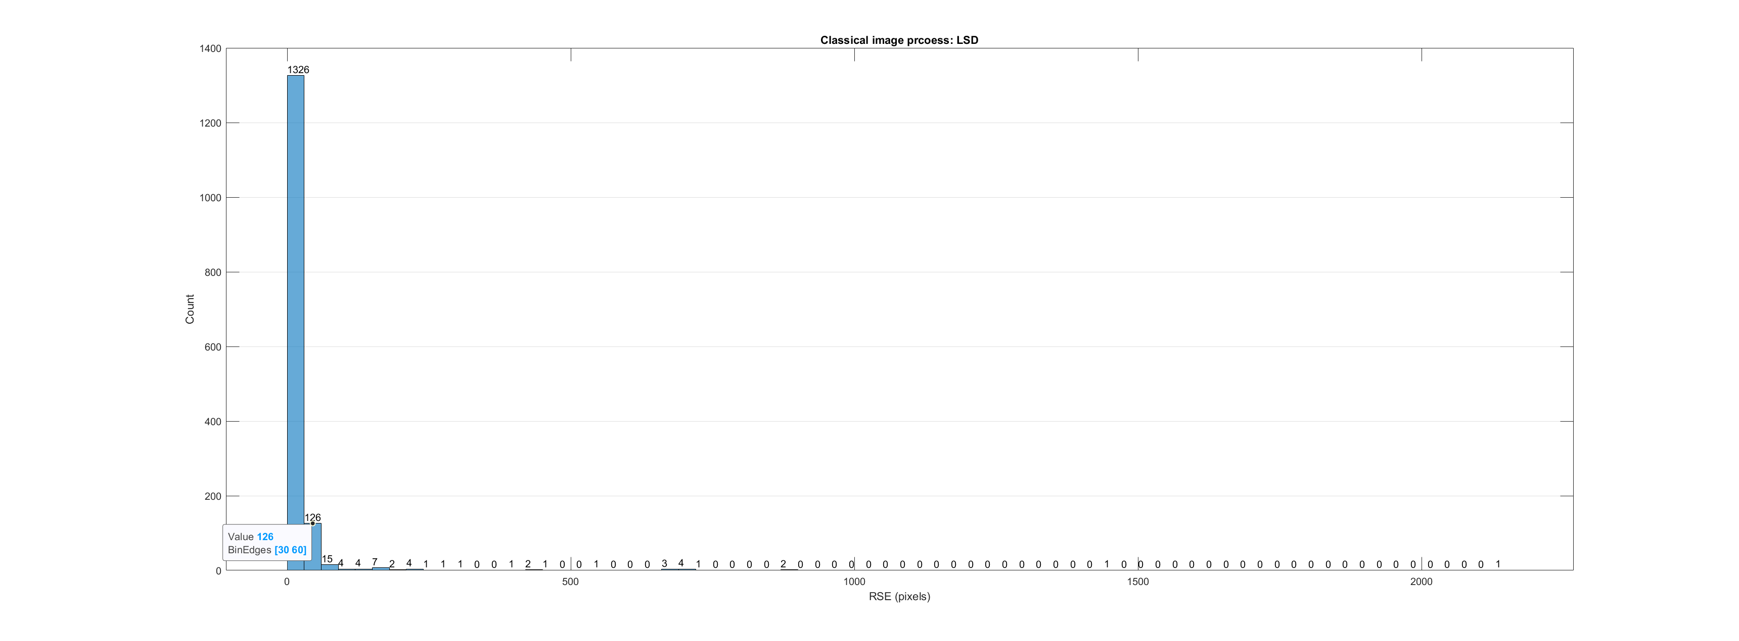
Evaluation: RSE
Classic image process: LSD

Slide 13
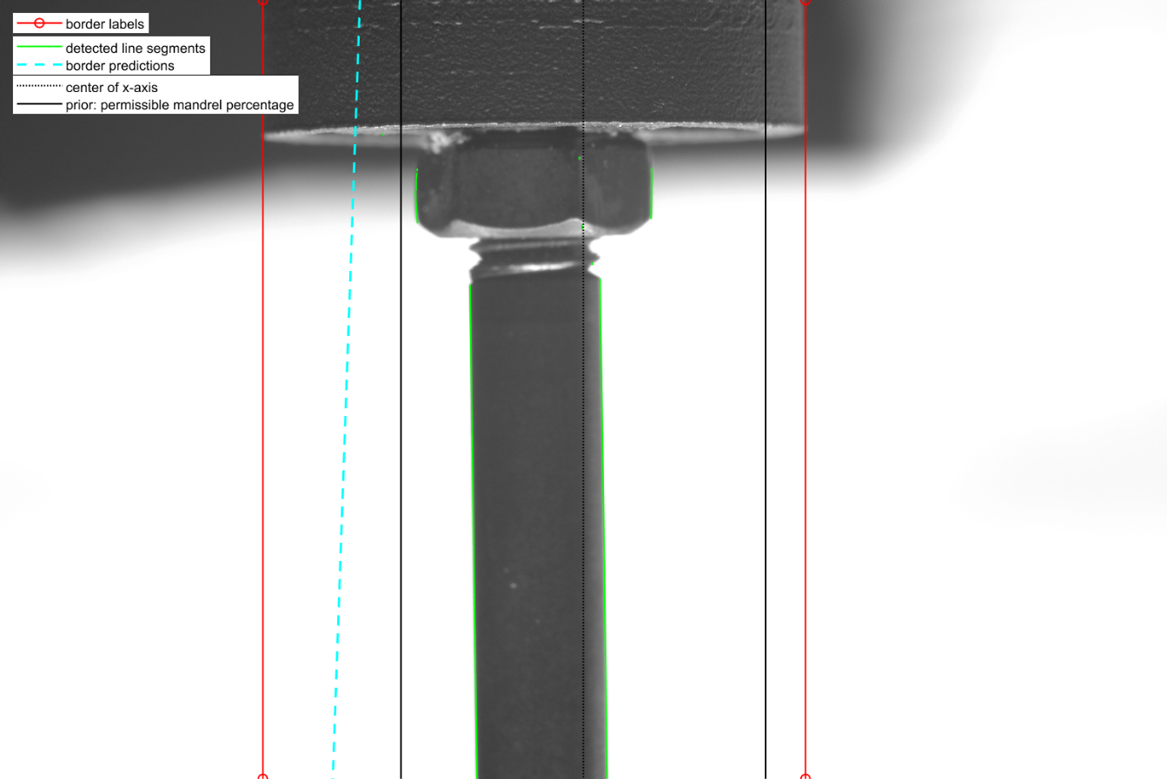
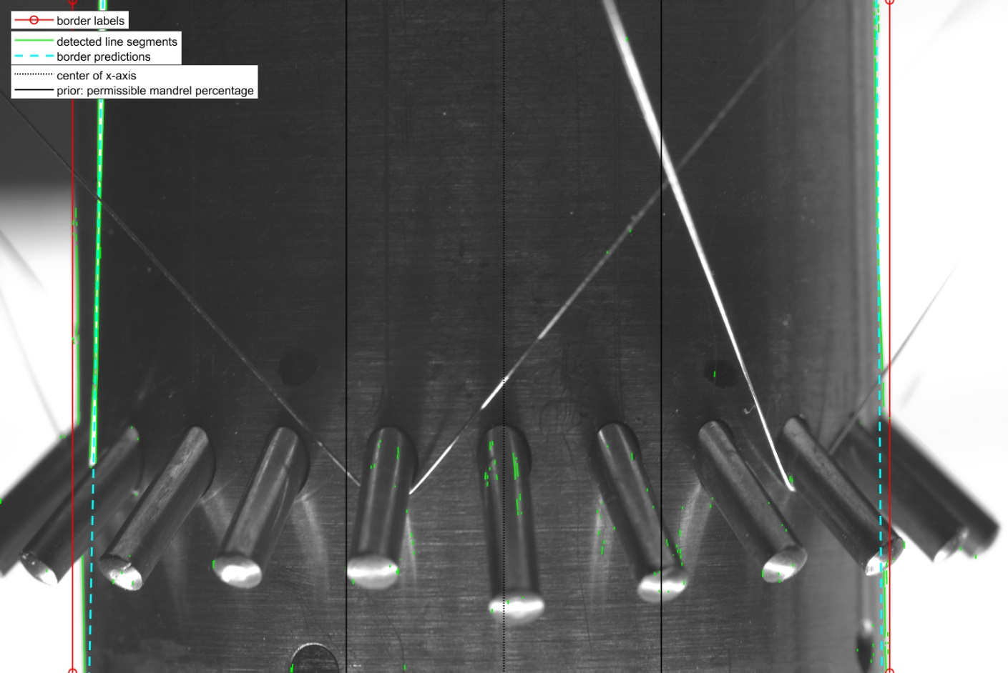
Evaluation: RSE
LSD: 2 kinds of bad cases
Case 1: no edge detected around the borders
Case 2: noise (stent wire) around the left border

Slide 14
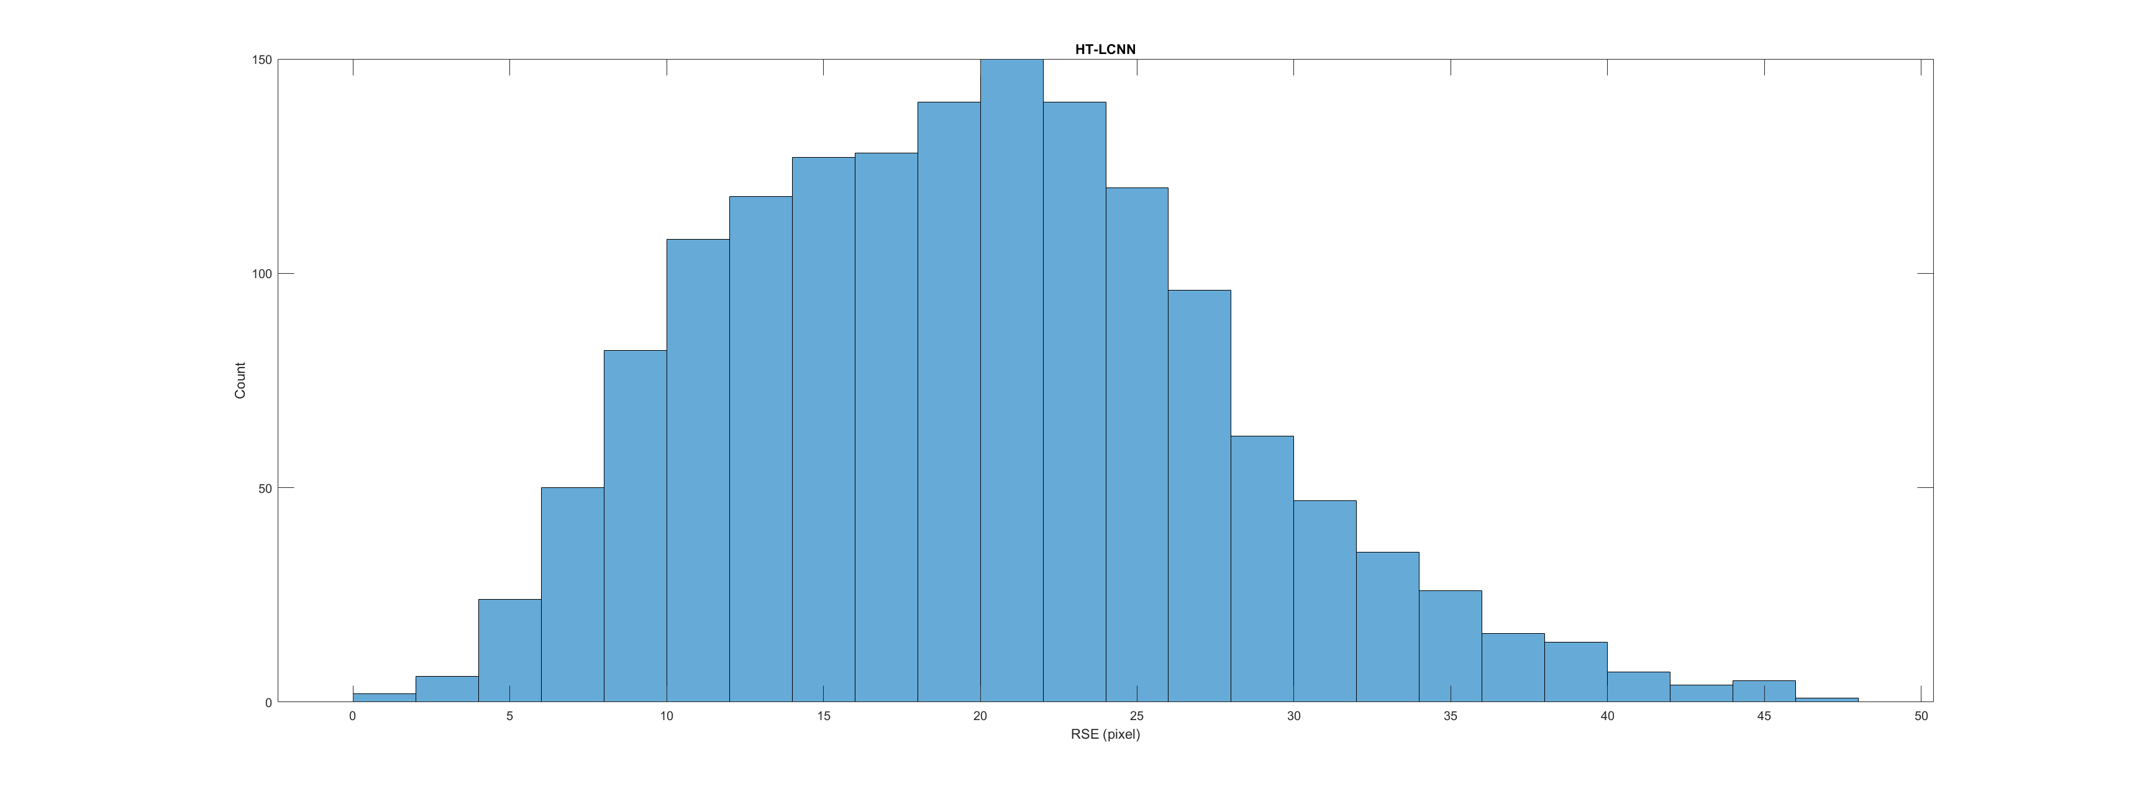
Evaluation: RSE
Deep learning: HT-LCNN

Slide 15
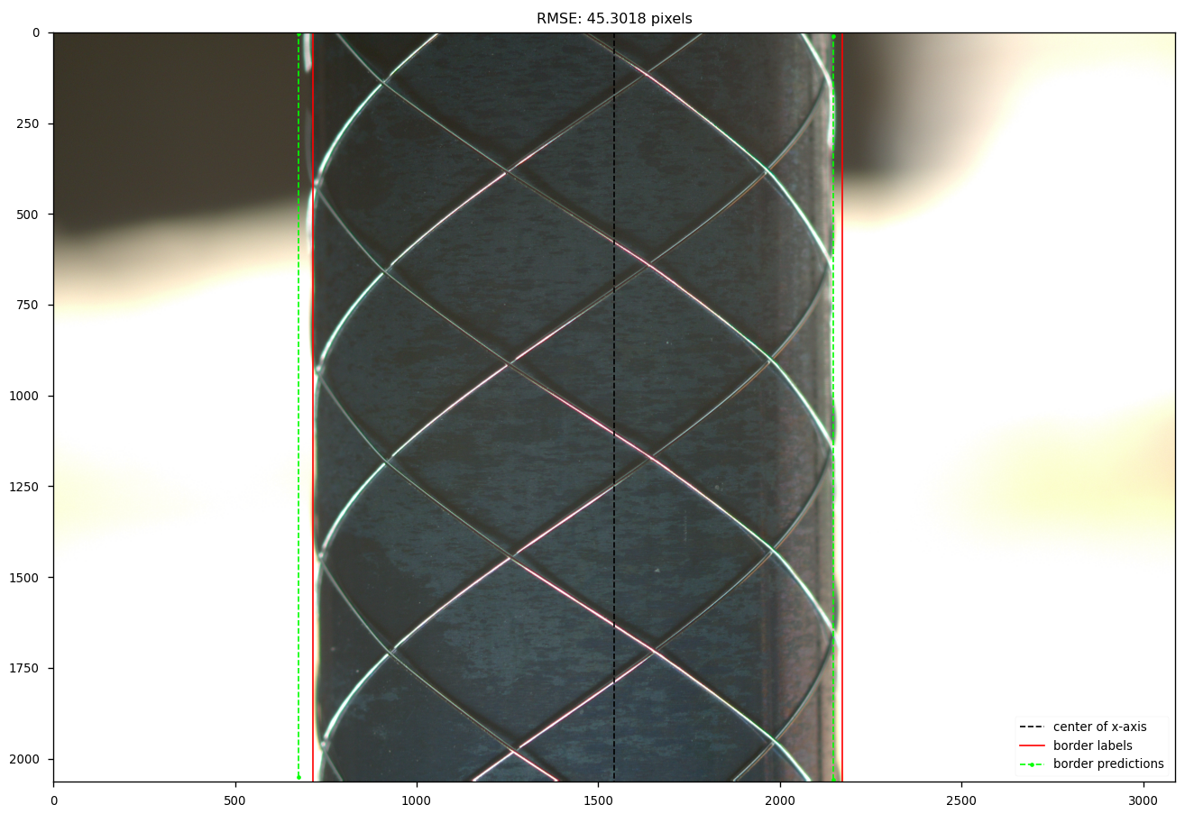
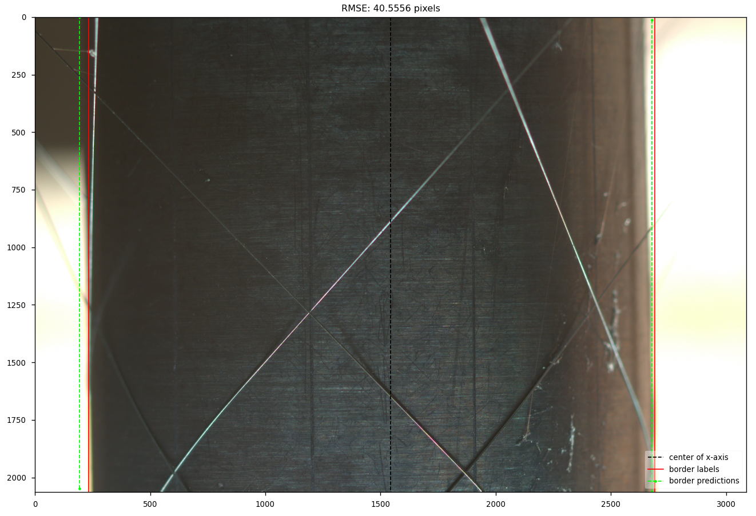
Evaluation: RSE
HT-LCNN: the predicted left border line in the left side of the labeled

Slide 16
Evaluation: execution time
Without MCMLSD

Slide 17
5 Conclusion and outlook
Conclusion:
Implemented / reproduced 6 approches to detect the border lines
4 in classic image process: LSD, EDLines, CannyPF, MCMLSD
2 in deep learning: HT-LCNN, F-Clip
Metric RSE:
DL models show better performance: more robust to the noise
Lowest of all: HT-LCNN 19.77 pixels
Lowest of classic methods: LSD 28.8 pixels
Metric execution time: F-Clip is the fastest with 32 (ms / image)
Outlook:
Classic image process: based on LSD, deal with the two bad cases (robust to noise)
Deep learning: try to use two junctions to represent a border line instead of the vertical line
compared to the top point of the left border (obstruction from the background), easy to percept for human being

Slide 18
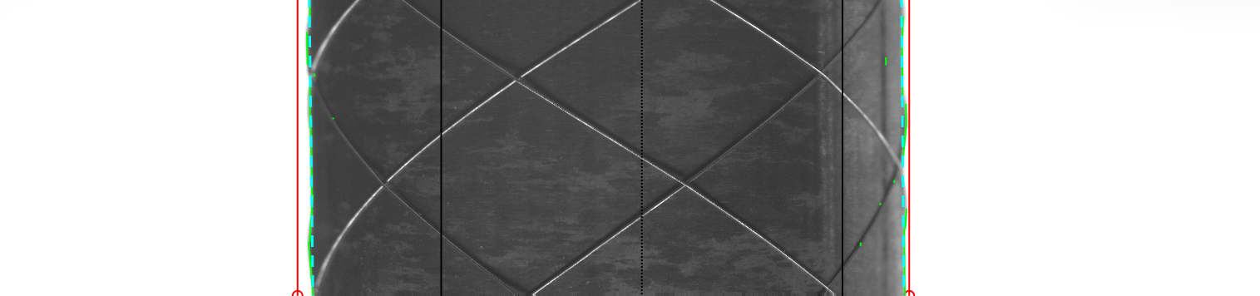
Thank you for your attention!

Slide 19
Appendix - Reference
[1]

